Slide 1
BOSS MOBILE PROJECT
2017144027 이승현
2018158015 박준희
2018158026 이정동

Slide 2
CONTENTS
01
02
03
04
INTODUCTION
SPRINT
FEATURE
END

Slide 3
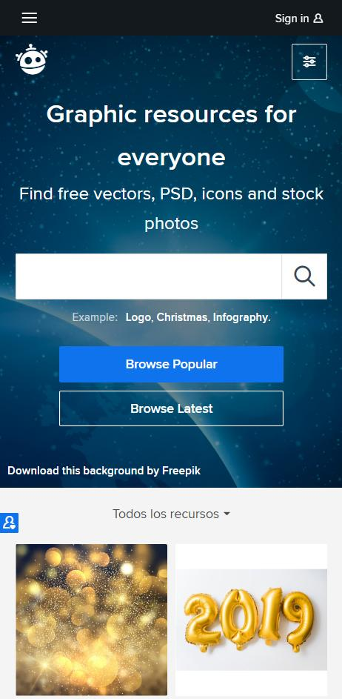


INTRODUCE
맛집 등록
지도에 핀 표시
NEPTUNE
Neptune is the eighth planet.
맛이어때
VER 1.0.0

Slide 4




Tools

Slide 5
Sprint 1 7.27~8.01

Slide 6
Sprint 2 8.02~8.8

Slide 7
Sprint 3 8.08~8.10

Slide 8
APP FEATURE

Slide 9
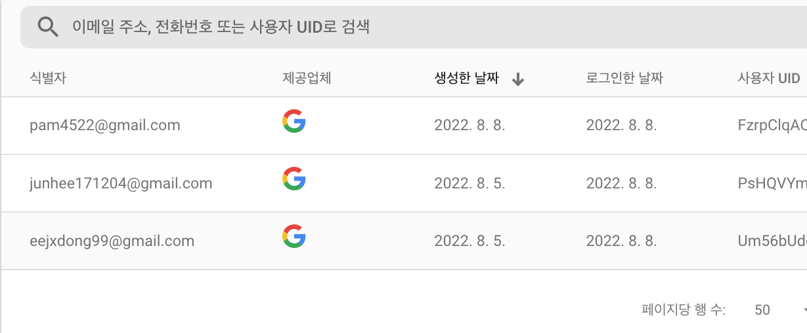
Sign In
NEPTUNE
Neptune is the eighth planet.

Slide 10
MAP
지역검색
지도 전환
내 위치 이동
NEPTUNE
NEPTUNE
Neptune is the eighth planet.
Neptune is the eighth planet.

Slide 11
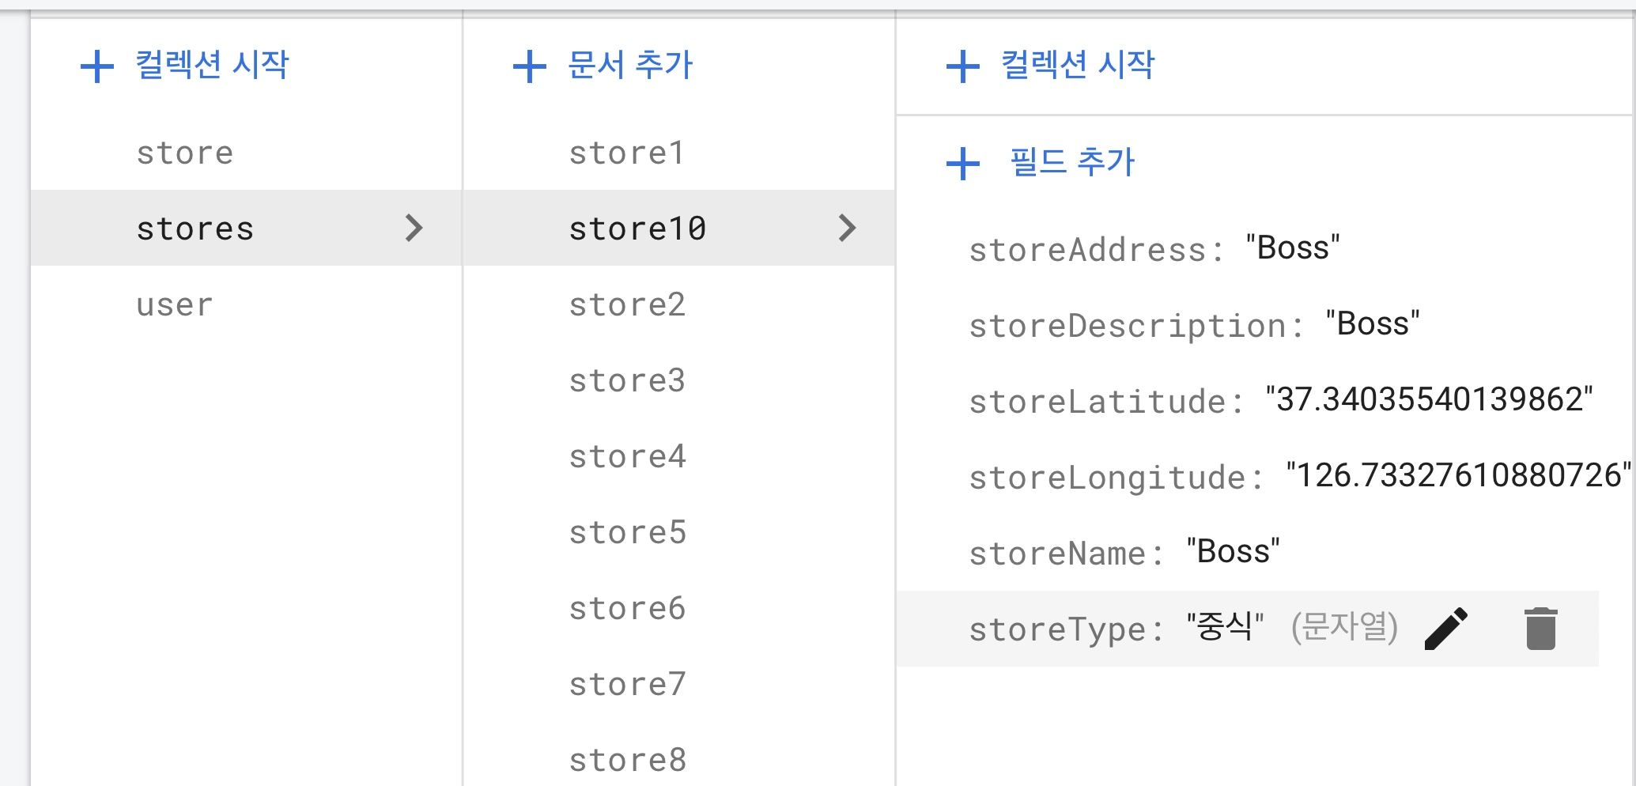
Server
Store Add
NEPTUNE
Neptune is the eighth planet.

Slide 12
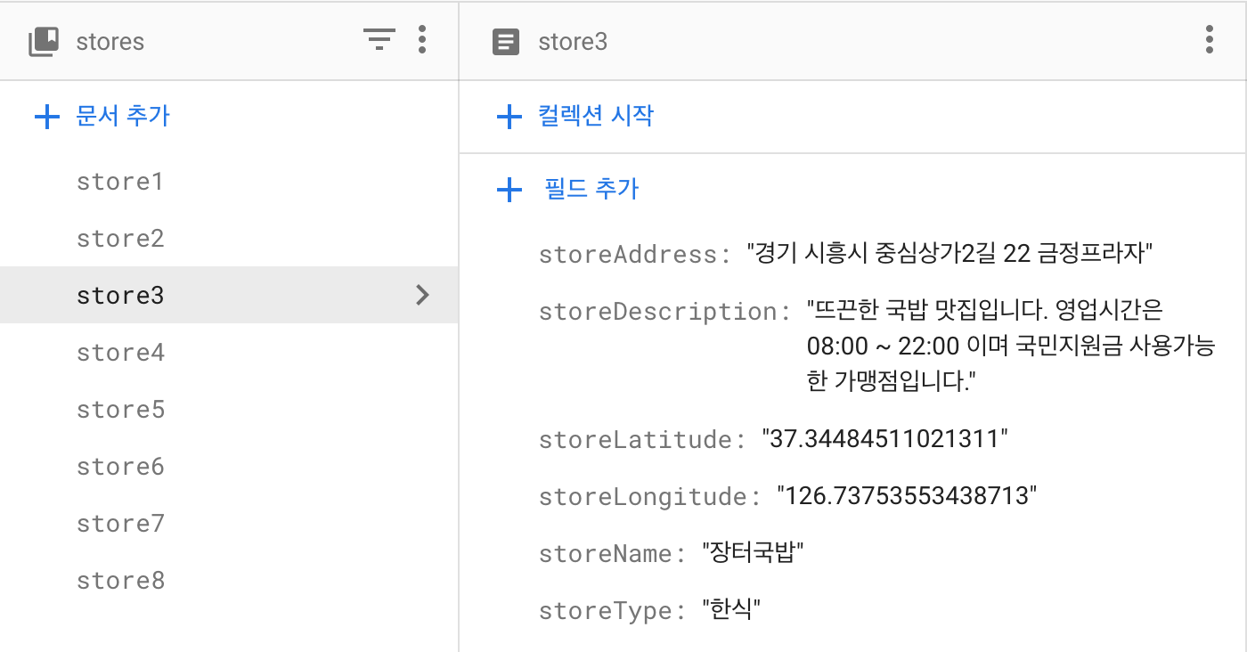
Store Info
Server
NEPTUNE
Neptune is the eighth planet.

Slide 13
Store List
NEPTUNE
Neptune is the eighth planet.

Slide 14
My Page
NEPTUNE
Neptune is the eighth planet.

Slide 15
Sign Out
NEPTUNE
Neptune is the eighth planet.

Slide 16
Thanks!

